Slide 1


IST – 659 Data admin concepts and Database Management
CUSE
SPORTS
Presented By:
Kishan Polekar
Prasun Abhishek Singh
Priyamvada Barve

Slide 2

Project Overview
This project proposes the development of a centralized system to manage all aspects related to sports events, teams, players, and venues in an educational institution. It will cater to three primary user groups: the public, players, and coaching staff.
The system will provide a user-friendly platform to access schedules, statistics, and team/player information. It will also help players plan their work and training accordingly, while coaching staff can use the system to manage teams efficiently, organise, and schedule games/events.
The project aims to streamline sports management, provide a central location for information, and enhance communication among stakeholders.

Slide 3

Goals
Develop a centralized system to manage all aspects of sports events, teams, players, and venues in an educational institution.
Create a user-friendly platform that provides easy access to schedules, and team/player information for the public, players, and coaching staff.
Improve planning and coordination among coaching staff and players by providing tools for efficient team management, analysis of player performance, and game scheduling.
Reduce the time and cost associated with managing sports events by centralizing all information related to sports management in one location.
Enhance communication among stakeholders, including coaching staff, players, and the public, by providing a centralized platform for all relevant information.
Facilitate effective decision-making by providing up-to-date, accurate, and easily accessible information to all stakeholders.
Ensure that the system is scalable and flexible enough to accommodate future growth and changes in the sports management landscape.

Slide 4

Specification
Entity Relationship Data Requirements/Business Rules
Conceptual Data Model
Logical Data Model
SQL/Up/Down Script to create/drop tables, keys constraints*
User Stories
External data model satisfying user stories
Triggers/Procedures
User Interface Design
*submitted as sql file

Slide 5
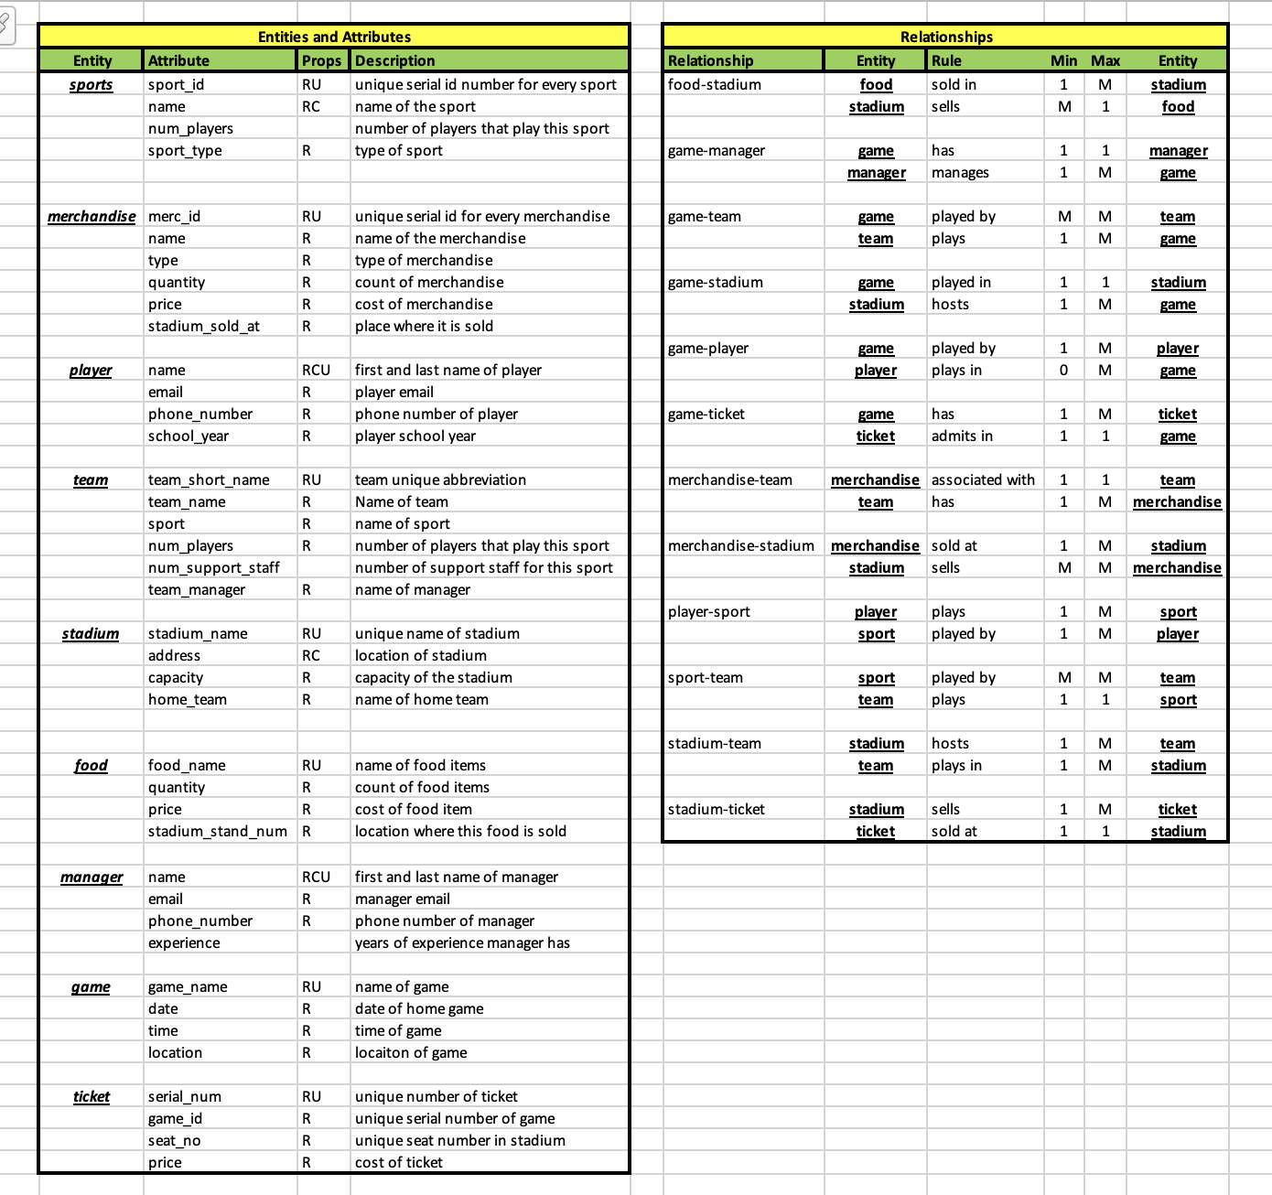
ERD /Data Requirements

Slide 6
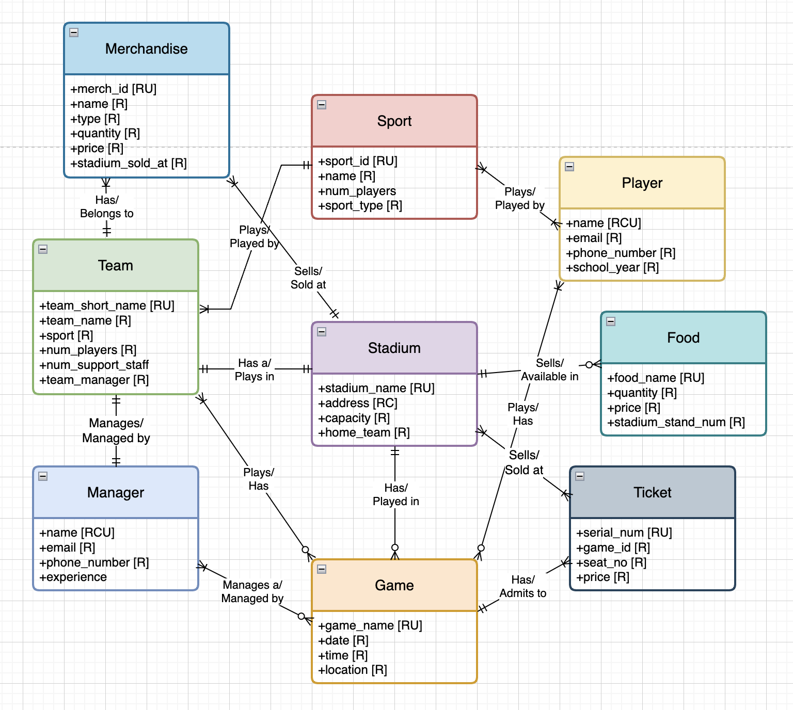

Conceptual Model

Slide 7

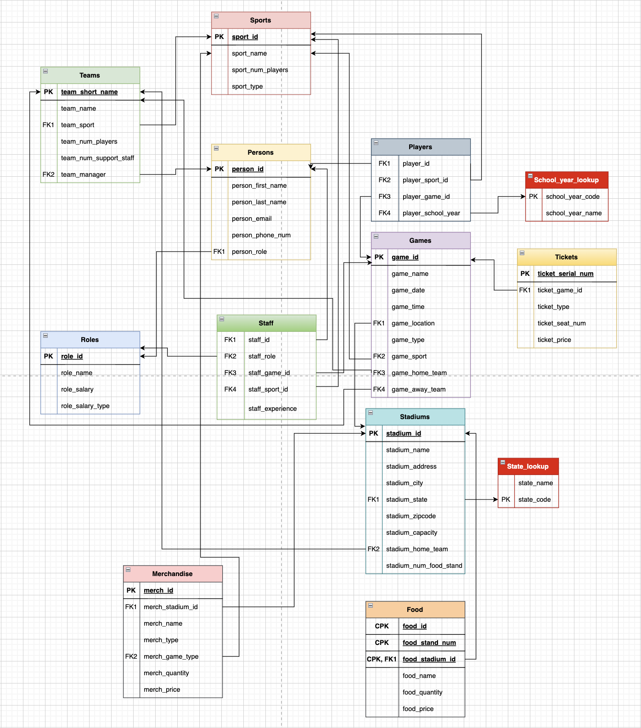
Logical Model

Slide 8

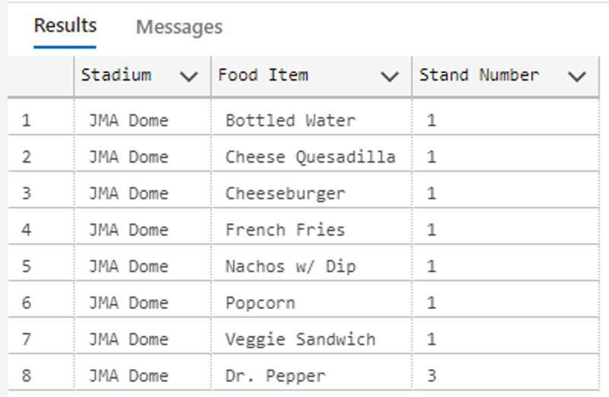
select stadium_name 'Stadium', food_name 'Food Item', food_stand_num 'Stand Number'
from food f inner join stadiums s on f.food_stadium_id = s.stadium_id
where food_quantity > 0 and stadium_name like '%Dome%'
group by stadium_name, food_stand_num, food_name
1. As a user, I would like to know which stands in a particular stadium sell which food item.

Slide 9
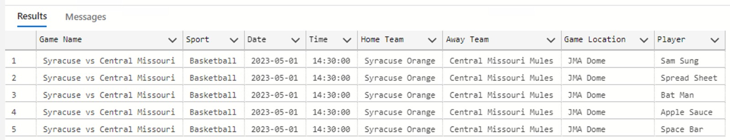
select game_name 'Game Name', game_sport 'Sport', game_date 'Date', game_time 'Time',
(select team_name from teams where team_short_name=g.game_home_team) 'Home Team',
(select team_name from teams where team_short_name=g.game_away_team) 'Away Team',
stadium_name 'Game Location',
person_first_name + ' ' + person_last_name as 'Player'
from games g, stadiums s, players p, persons per
where stadium_name like '%Dome%' and
p.player_game_id = g.game_id and
p.player_id = per.person_id and
g.game_date = (select top(1) game_date from games)
2. As a user, I would like to know which teams and players are playing in an upcoming game at the Dome.

Slide 10

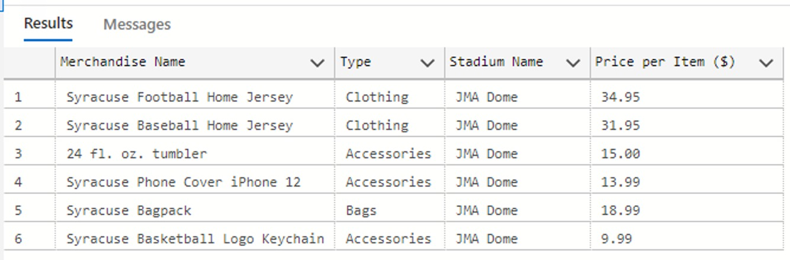
select merch_name 'Merchandise Name', merch_type 'Type',
stadium_name 'Stadium Name', merch_price 'Price per Item ($)'
from merchandise m, stadiums s
where s.stadium_name like '%Dome%' and
merch_stadium_id = stadium_id
3. List of all merchandise available at a particular stadium.

Slide 11
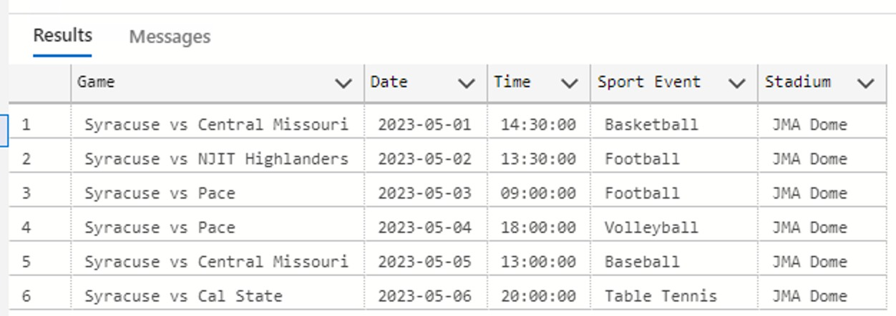
select game_name 'Game', game_date 'Date', game_time 'Time',
game_sport 'Sport Event', stadium_name 'Stadium'
from games g, stadiums s
where game_location = stadium_id and
stadium_name like '%Dome%'
order by game_date, game_time
4. List of all upcoming events at the Dome.

Slide 12

create procedure p_upsert_team (
@team_abv char(3),
@team_name varchar(50)
) as begin
if exists (select * from teams where team_short_name = @team_abv)
begin
update teams set team_name = @team_name
where team_short_name = @team_abv
end
else begin
insert into teams
values (@team_abv, @team_name, 1, 1, NULL, NULL)
end
end
GO
select * from teams
5. Procedure to update a team's name.
If the team exists, then the name is updated, but -- if there is no such team, it is added to the teams table.

Slide 13
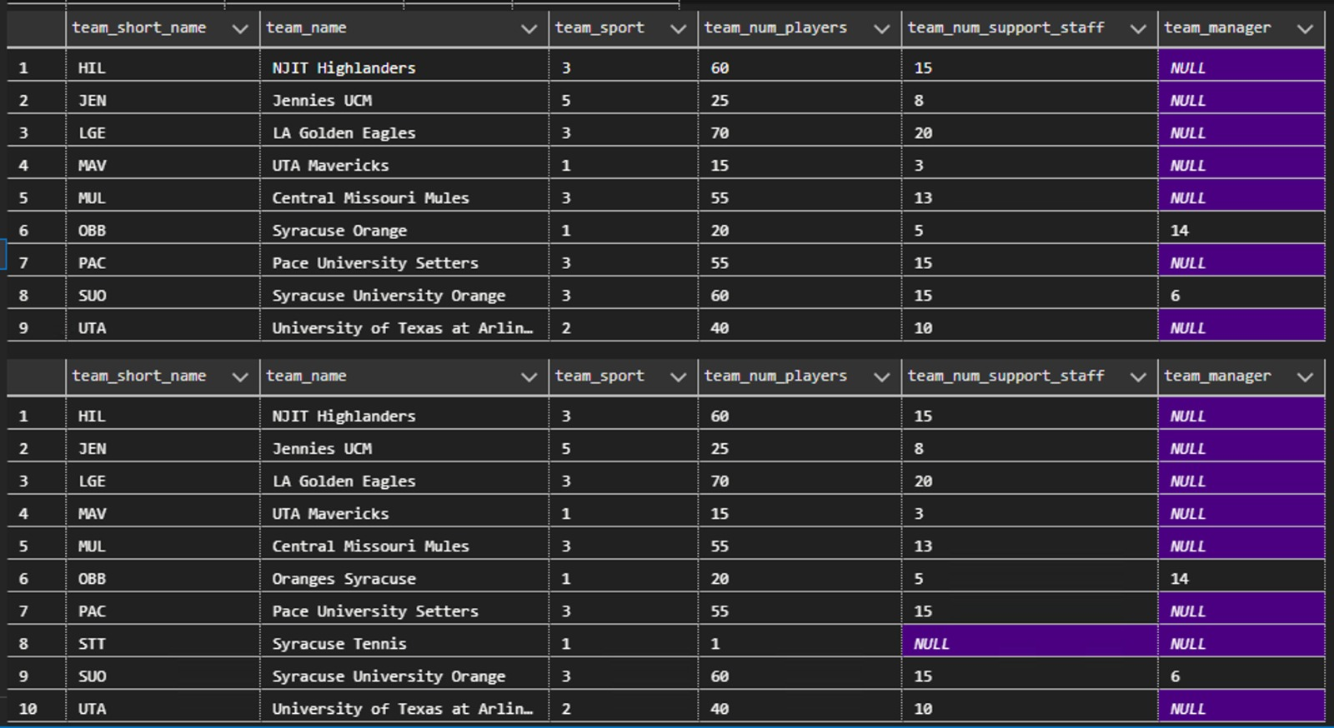
exec p_upsert_team 'OBB', 'Oranges Syracuse'
exec p_upsert_team 'STT', 'Syracuse Tennis'
select * from teams
GO

Slide 14
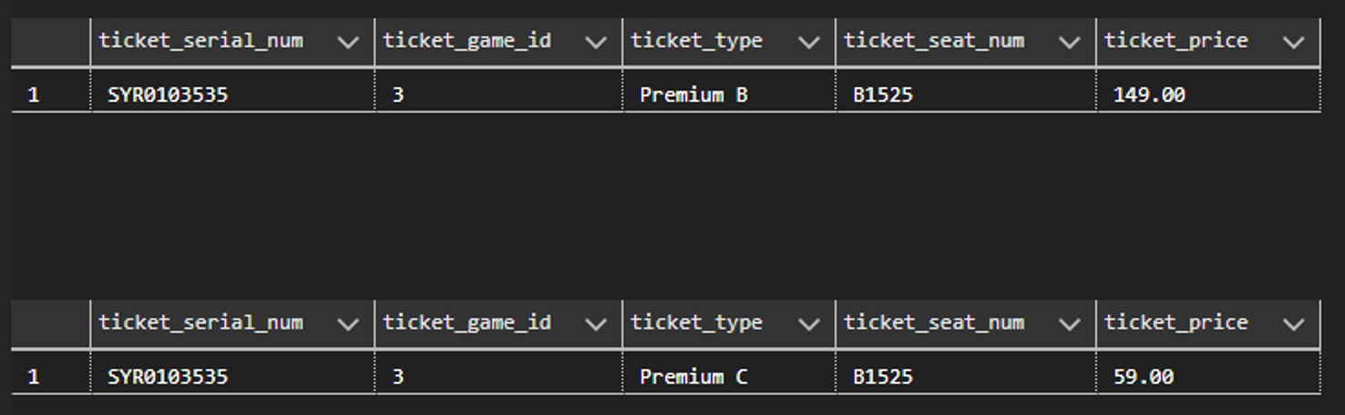
select * from tickets where ticket_serial_num= 'SYR0103535'
GO
create trigger t_update_price
on tickets
after update, insert as
begin
declare @ticket_type varchar(50)
if exists (select i.ticket_price from inserted i)
update tickets set ticket_price = 59
where ticket_type in (select ticket_type from inserted i)
end
GO
select * from tickets where ticket_serial_num='SYR0103535'
update tickets set ticket_type = 'Premium C' where ticket_serial_num='SYR0103535'
select * from tickets where ticket_serial_num='SYR0103535'
GO
6. Trigger to update the price based on the ticket type

Slide 15
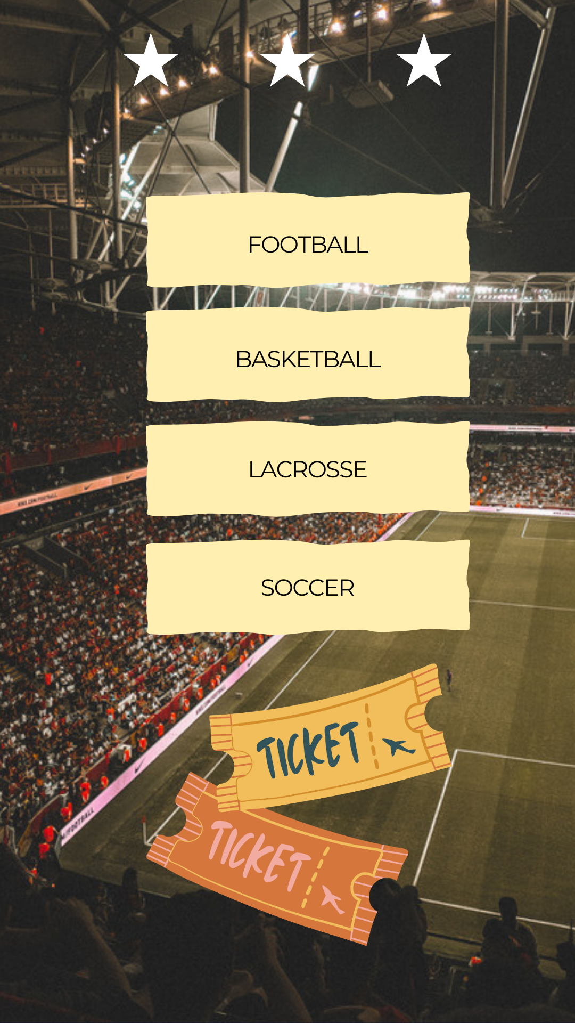
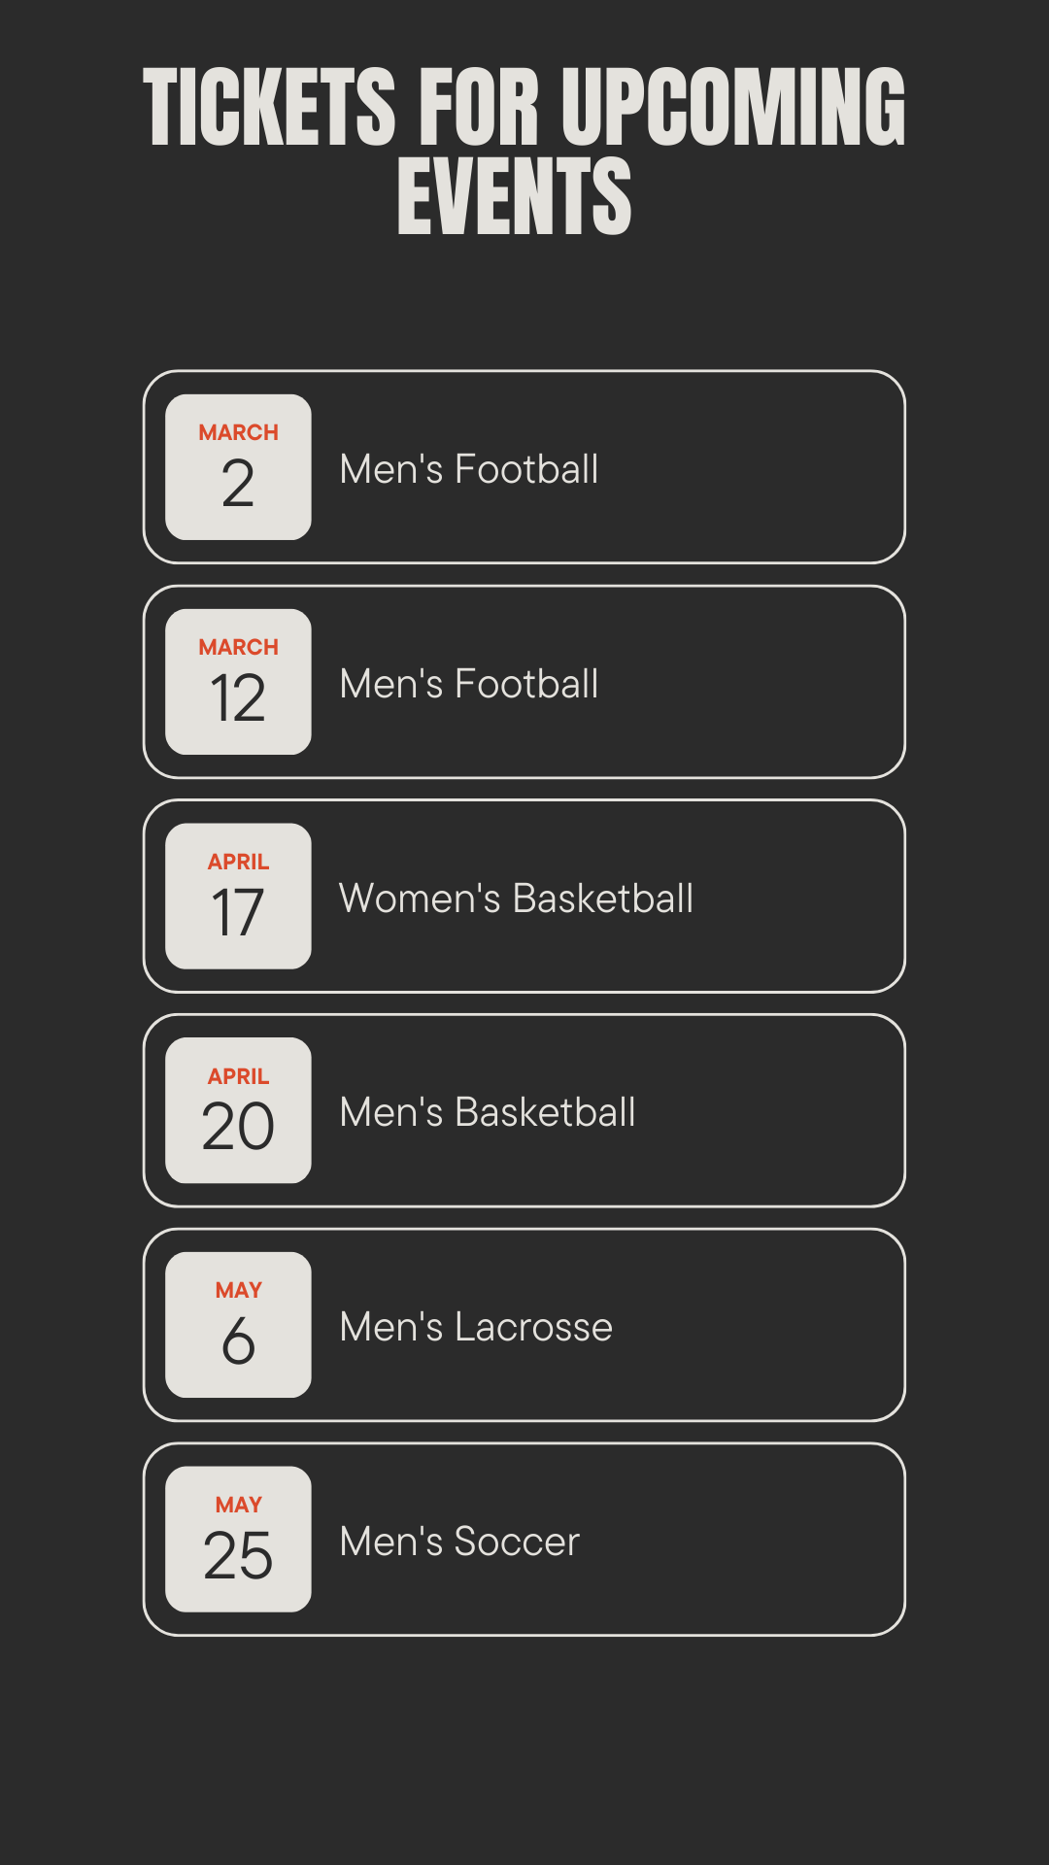
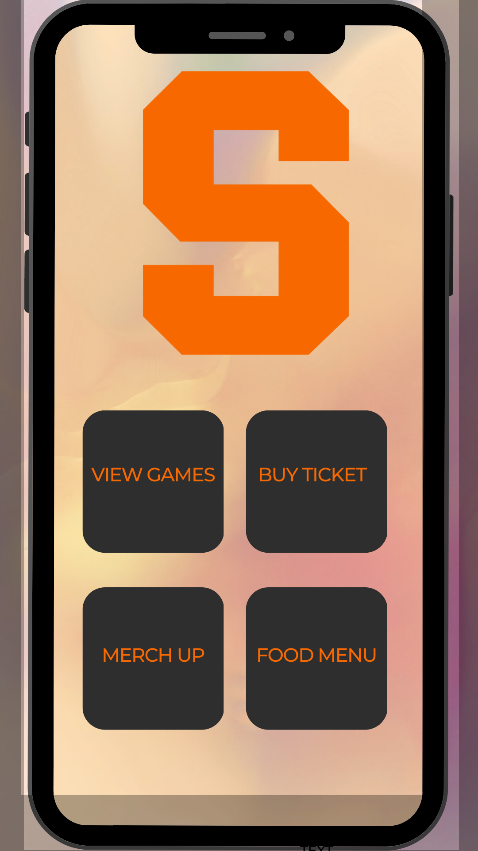
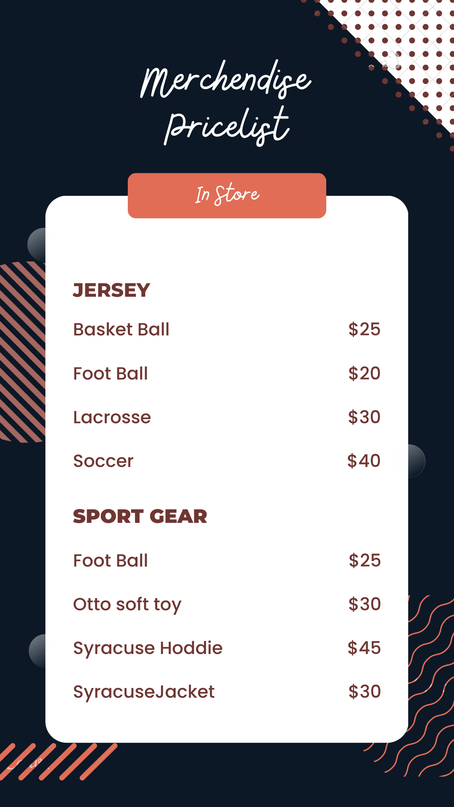
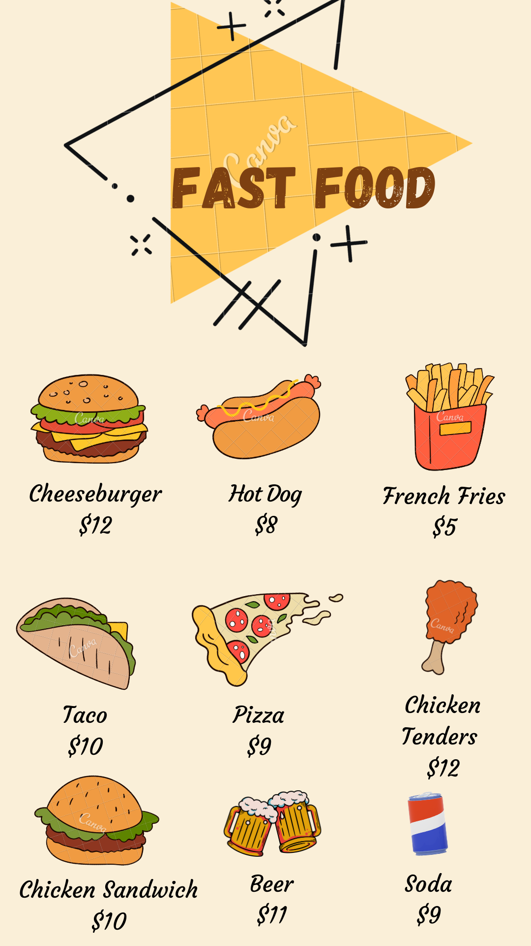
Logical Design of UI layout

Slide 16


